Slide 1
Queue

Slide 2
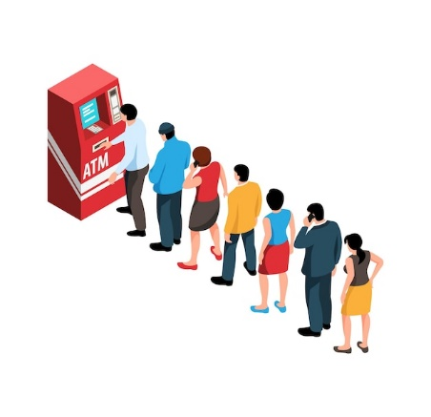
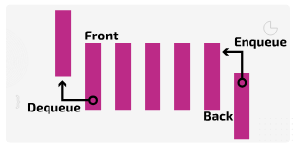
Queue
A queue is a linear data structure that contains elements in an ordered sequence. It is an abstract data type, pretty similar to a stack data structure and also different fundamentally.
We insert data at one end of the queue and remove data from the other end.
It follow First In First Out principle.

Slide 3
Real-life applications of queue
Here are a few more real-life applications of queues:
Luggage checking machine
Vehicles on toll tax bridge
One way exits
Patients waiting outside the doctor’s clinic
Phone answering systems
Cashier line in a store

Slide 4
CPU scheduling- to keep track of processes for the CPU
Handling website traffic - by implementing a virtual HTTP request queue
Printer Spooling - to store print jobs
In routers - to control how network packets are transmitted or discarded
Traffic management - traffic signals use queues to manage intersections

Slide 5
C++ Queue Methods
Methods | Description
push() | Inserts an element at the back of the queue.
pop() | Removes an element from the front of the queue.
front() | Returns the first element of the queue.
back() | Returns the last element of the queue.
size() | Returns the number of elements in the queue.
empty() | Returns true if the queue is empty.

Slide 6
Types of Queues
Simple Queue (Linear Queue): Basic queue where elements are added at the rear and removed from the front.
Circular Queue: The last position is connected back to the first to make a circular queue, solving the limitation of unused space in a linear queue.
Priority Queue: Each element has a priority, and elements are dequeued based on priority rather than just FIFO.
Double-ended Queue (Deque): Insertion and deletion can occur at both ends (front and rear).

Slide 7

Simple Queue
In a simple queue, insertion takes place at the rear and removal occurs at the front. It strictly follows the FIFO (First in First out) rule.
Simple queue

Slide 8
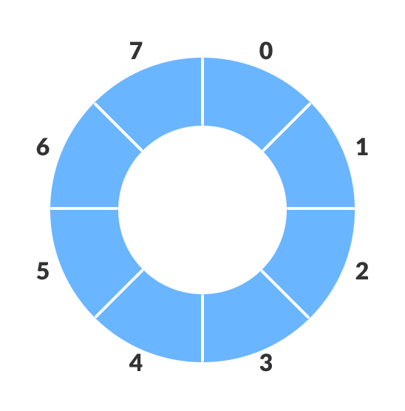
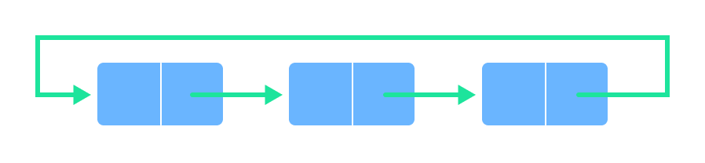
Circular Queue
In a circular queue, the last element points to the first element making a circular link.

Slide 9
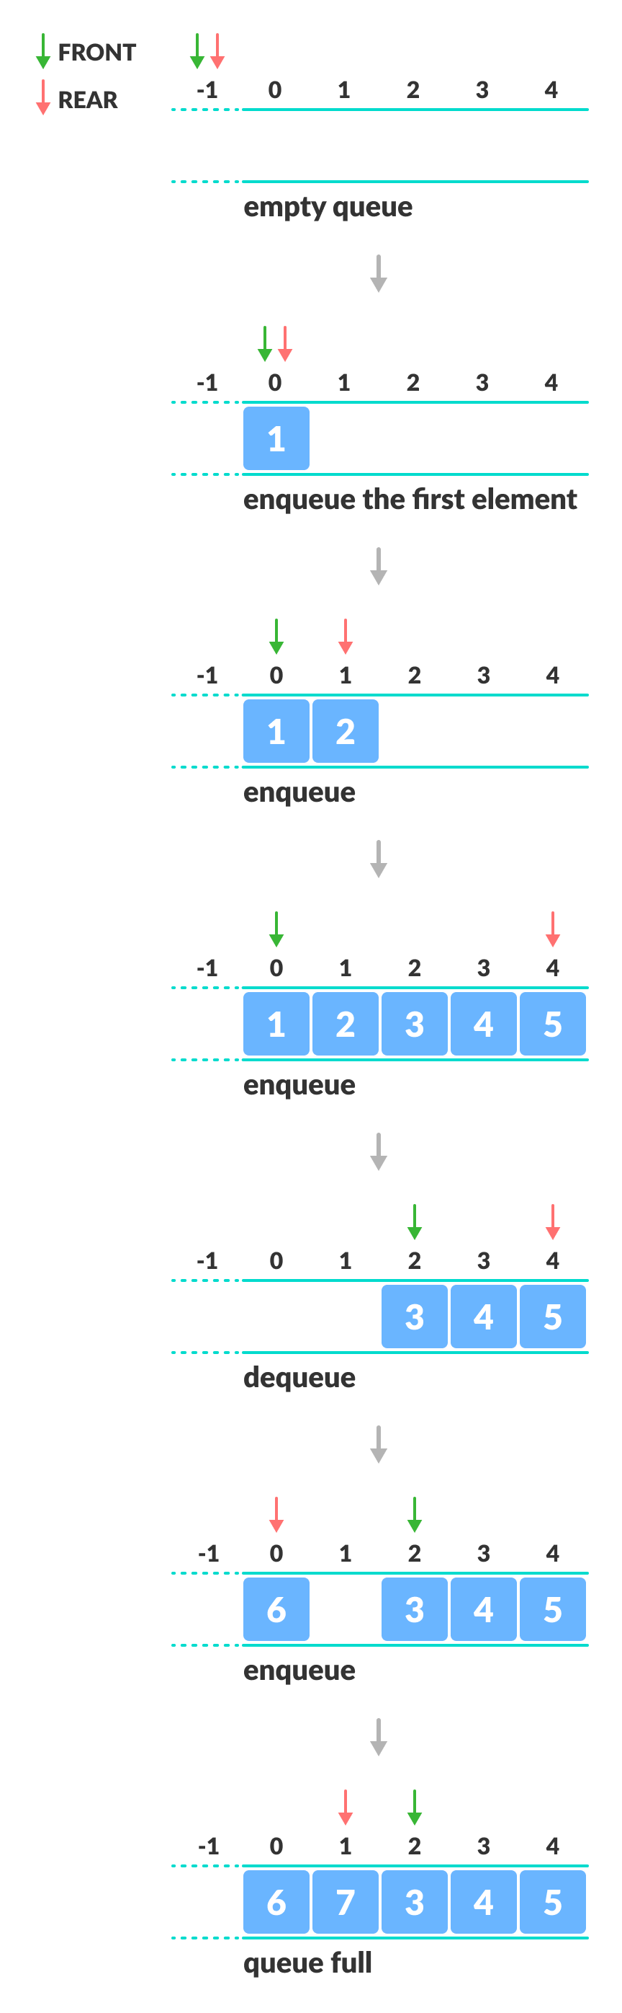
check for full queue has a new additional case:
Case 1: FRONT = 0 && REAR == SIZE - 1
Case 2: FRONT = REAR + 1

Slide 10
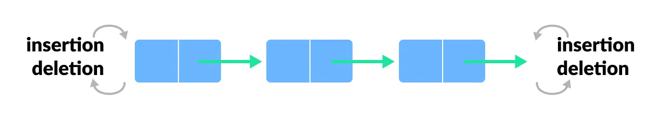
Deque (Double Ended Queue)
In a double ended queue, insertion and removal of elements can be performed from either from the front or rear. Thus, it does not follow the FIFO (First In First Out) rule.

Slide 11
Types of Deque
Input Restricted Deque
In this deque, input is restricted at a single end but allows deletion at both the ends.
Output Restricted Deque
In this deque, output is restricted at a single end but allows insertion at both the ends.

Slide 12
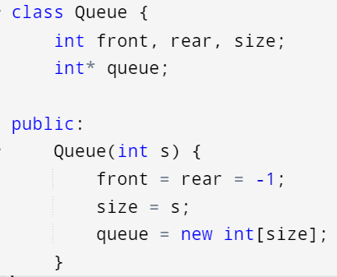
Linear Queue: Array implementation

Slide 13
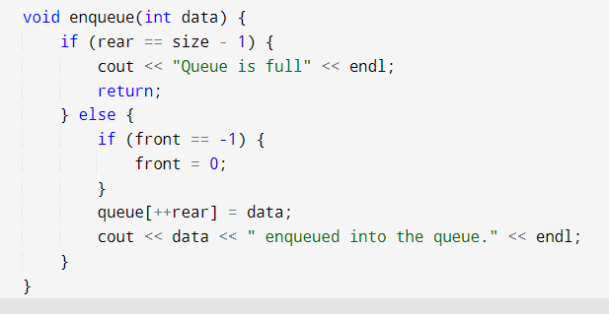
Linear Queue: Array implementation

Slide 14
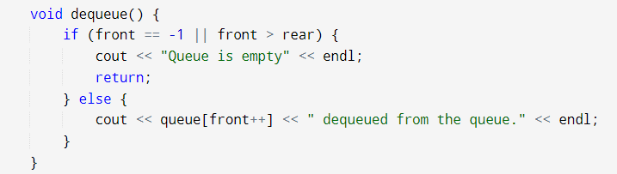
Linear Queue: Array implementation

Slide 15
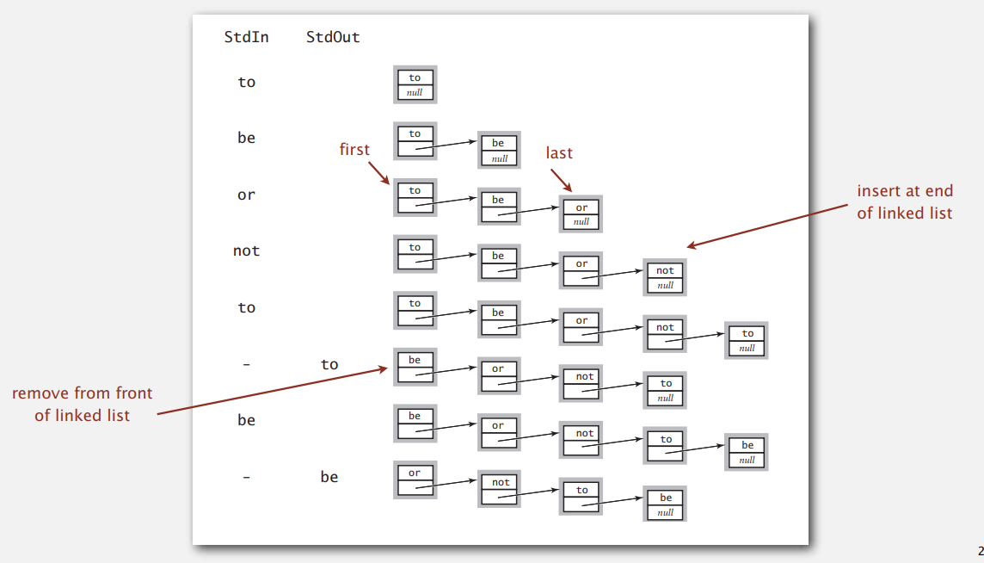
Queue: linked-list representation
Maintain pointer to first and last nodes in a linked list;
insert/remove from opposite ends

Slide 16
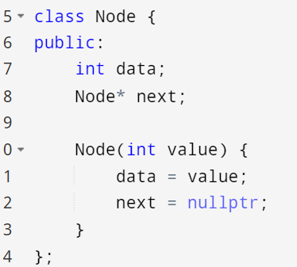
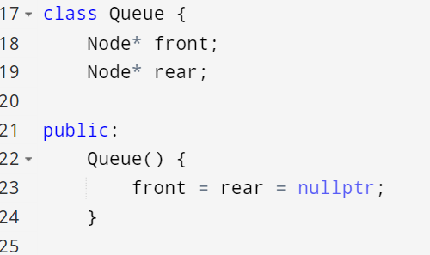

Slide 17
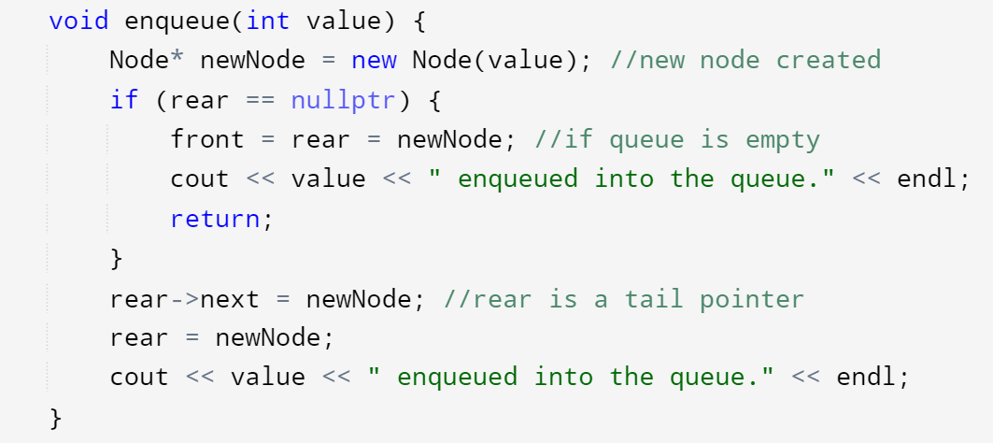

Slide 18
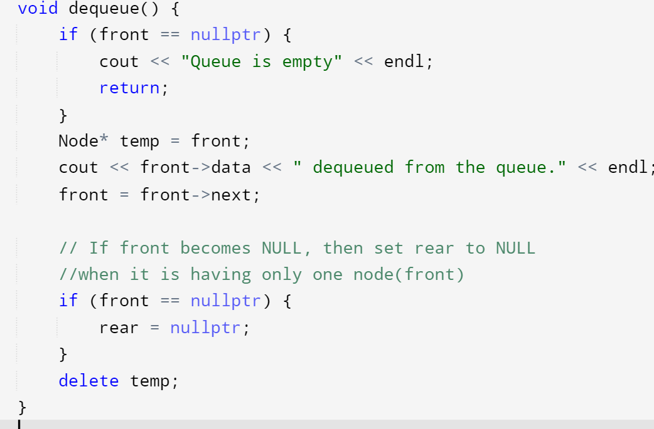

Slide 19
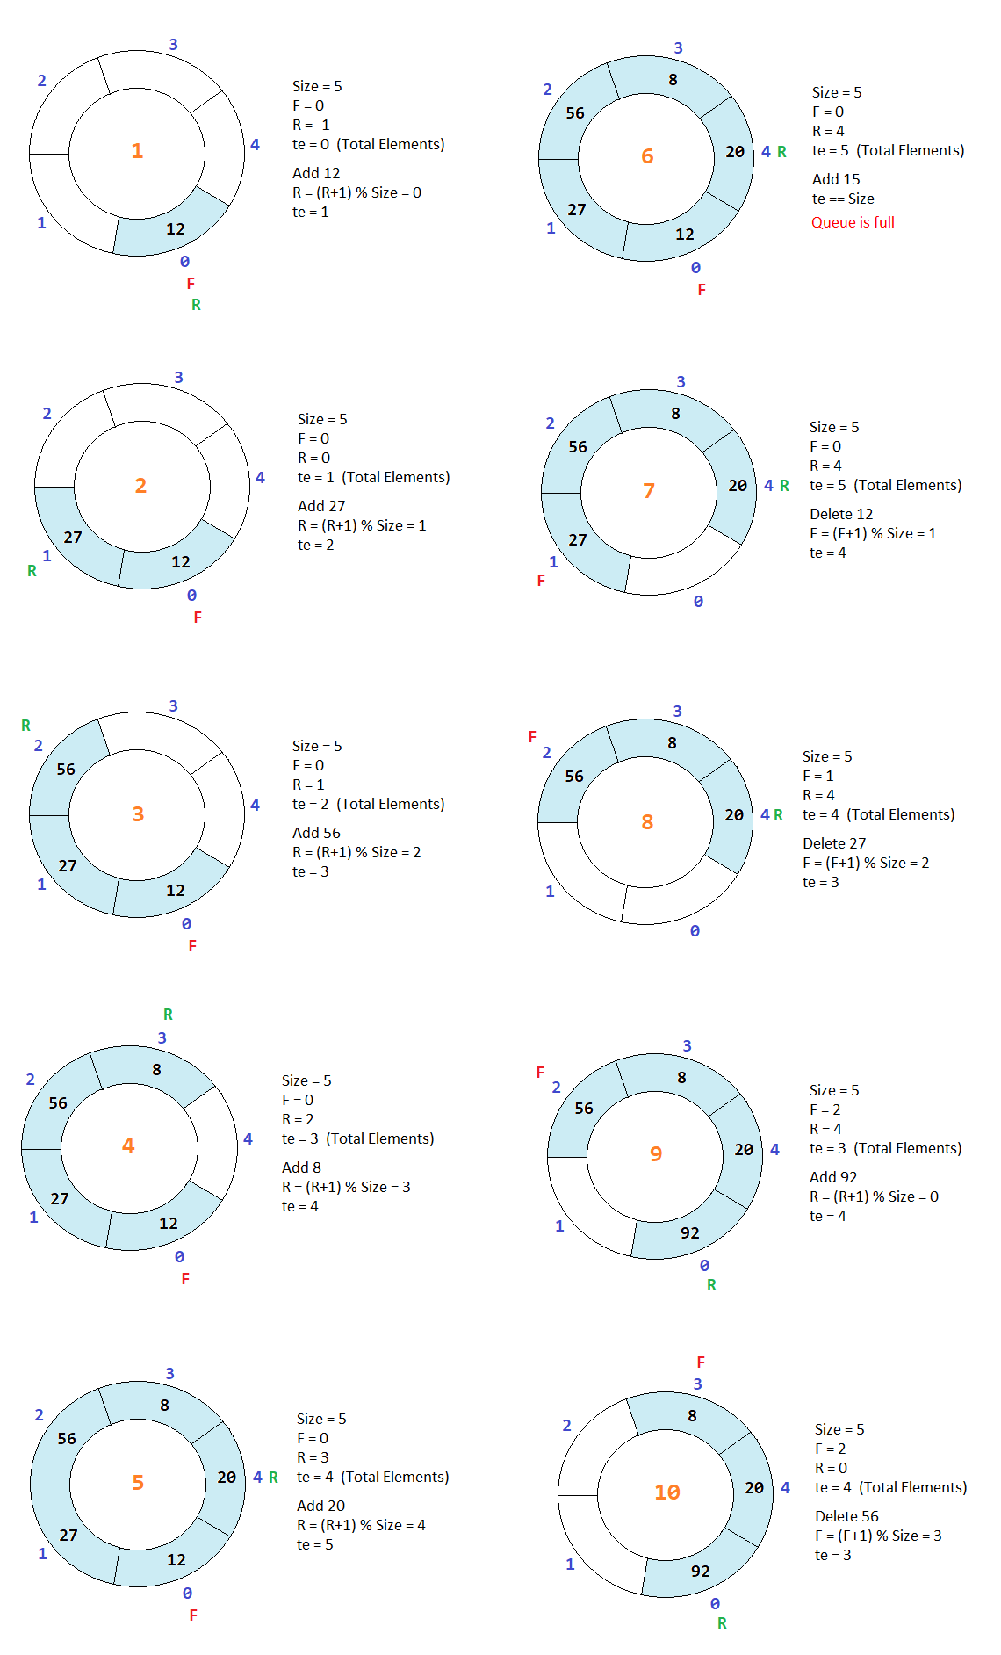
Circular Queue

Slide 20
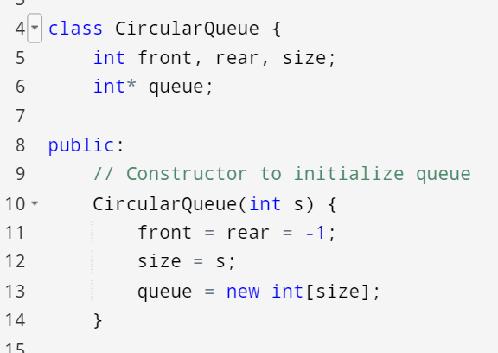
Circular Queue

Slide 21
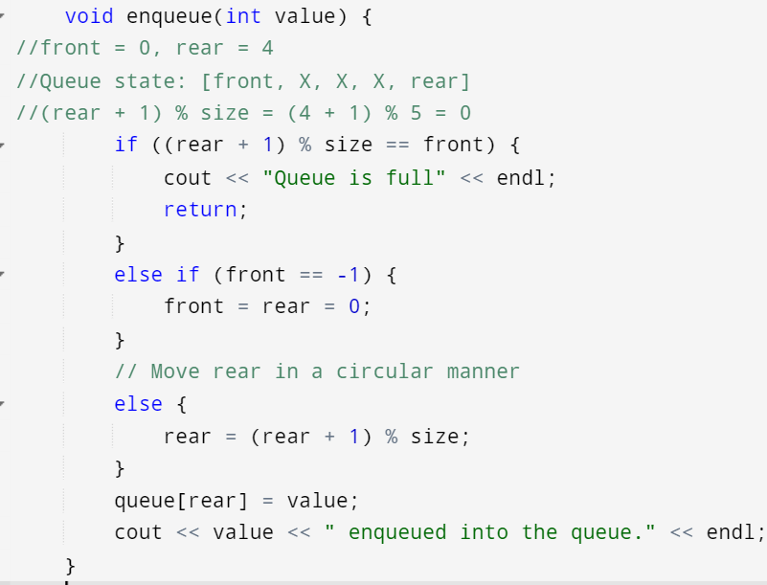

Slide 22
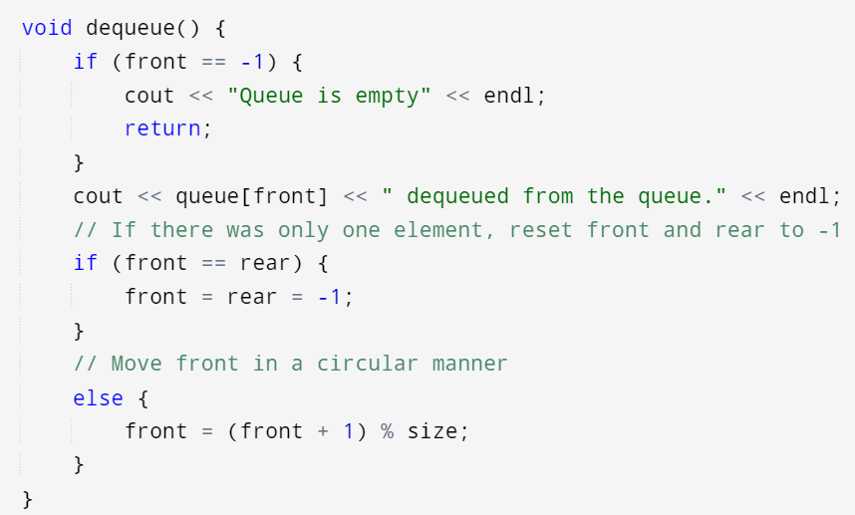

Slide 23
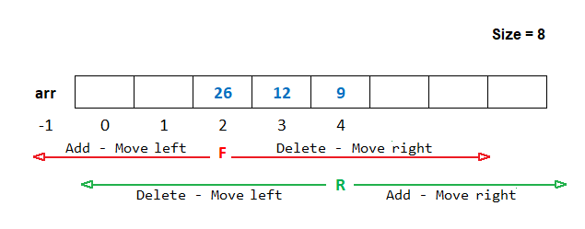
Double ended queue

